Slide 1
Boolean functions homework
Constantin Marian – Group 912

Slide 2
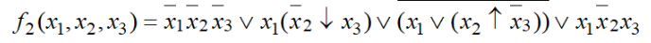
Exercise 3.2
Using Veitch diagrams, simplify the following Boolean function:

Slide 3
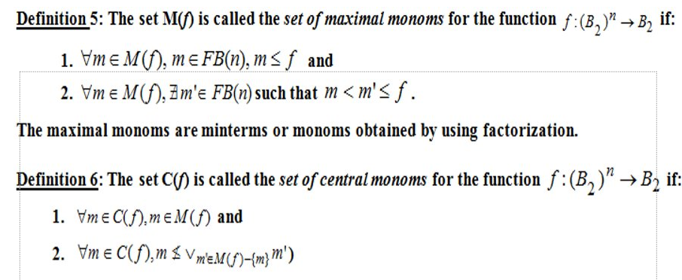
Theoretical results

Slide 4
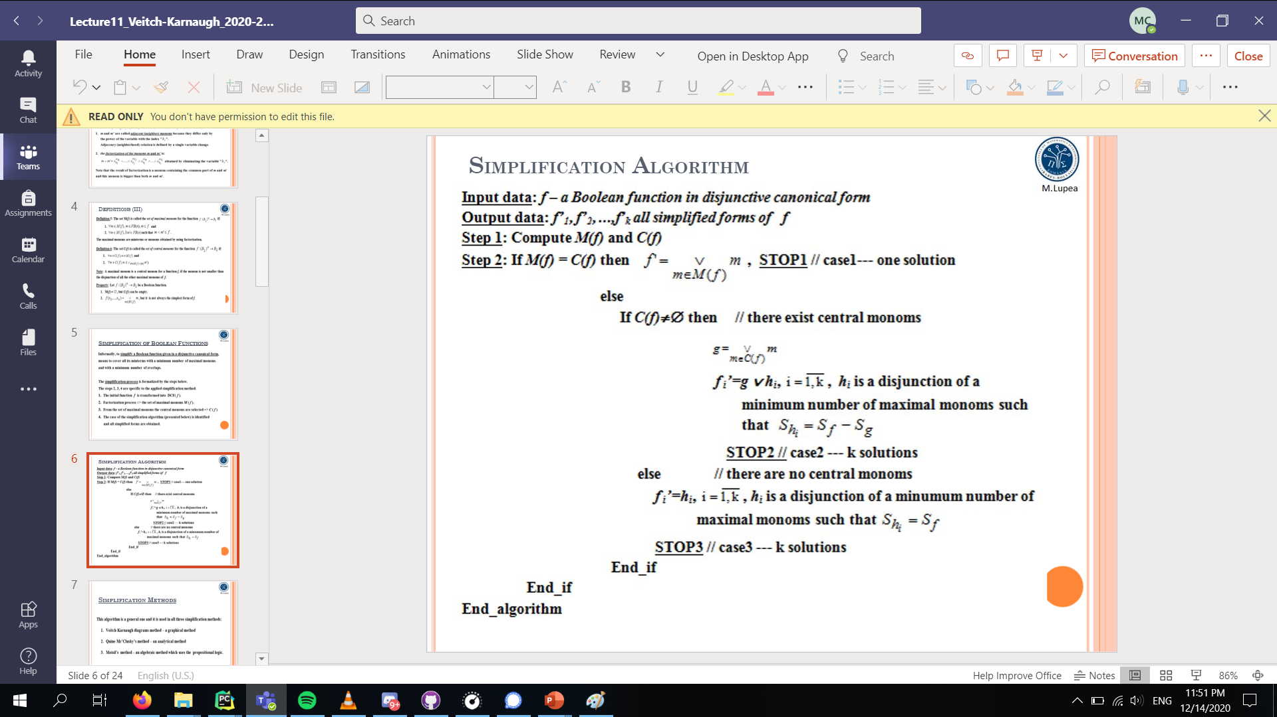

Slide 5
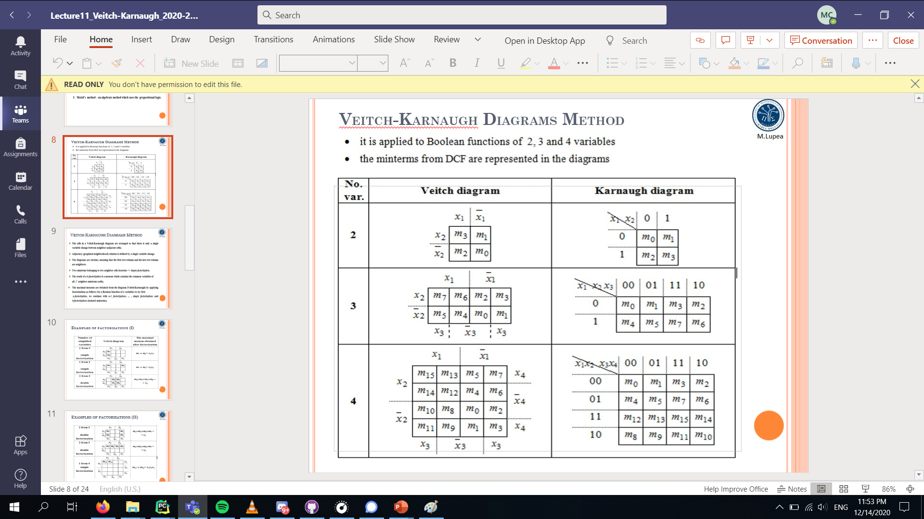

Slide 6
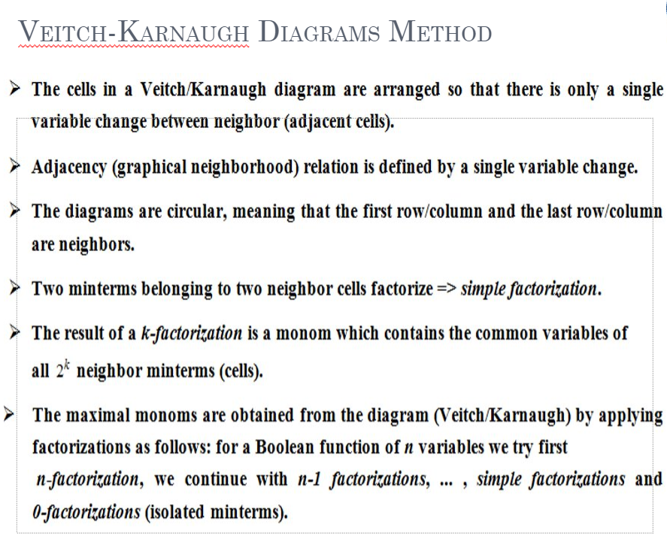

Slide 7
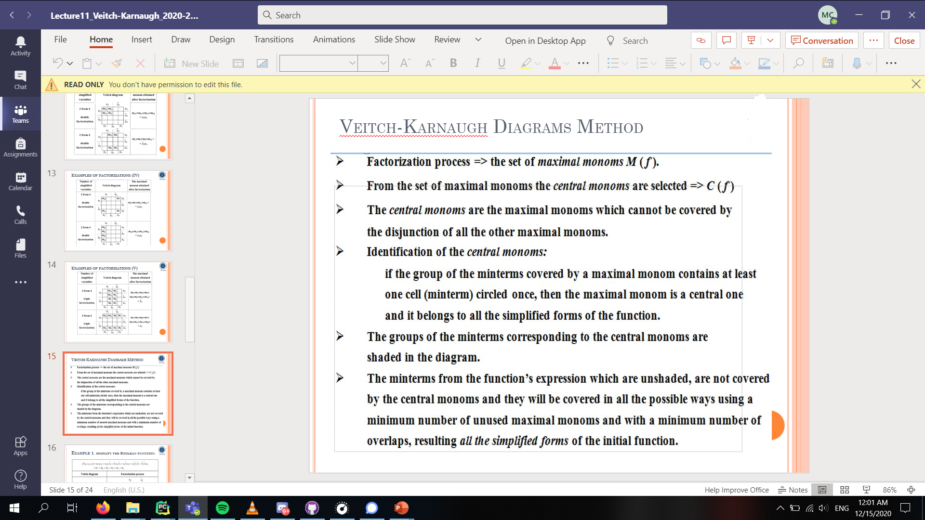

Slide 8
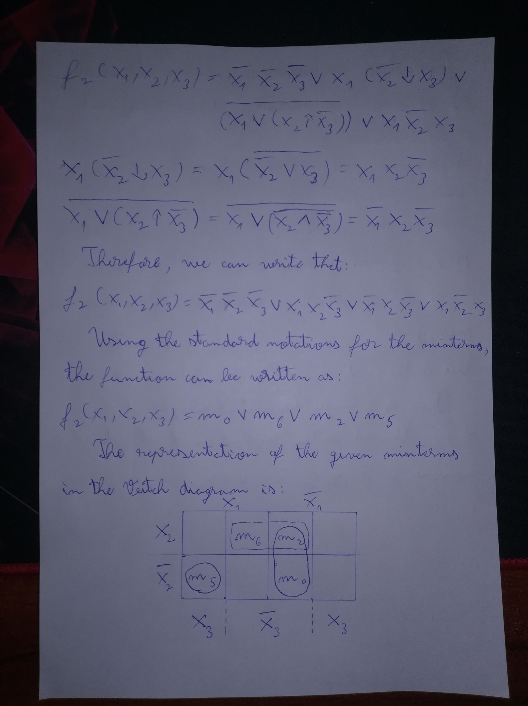
Solution

Slide 10
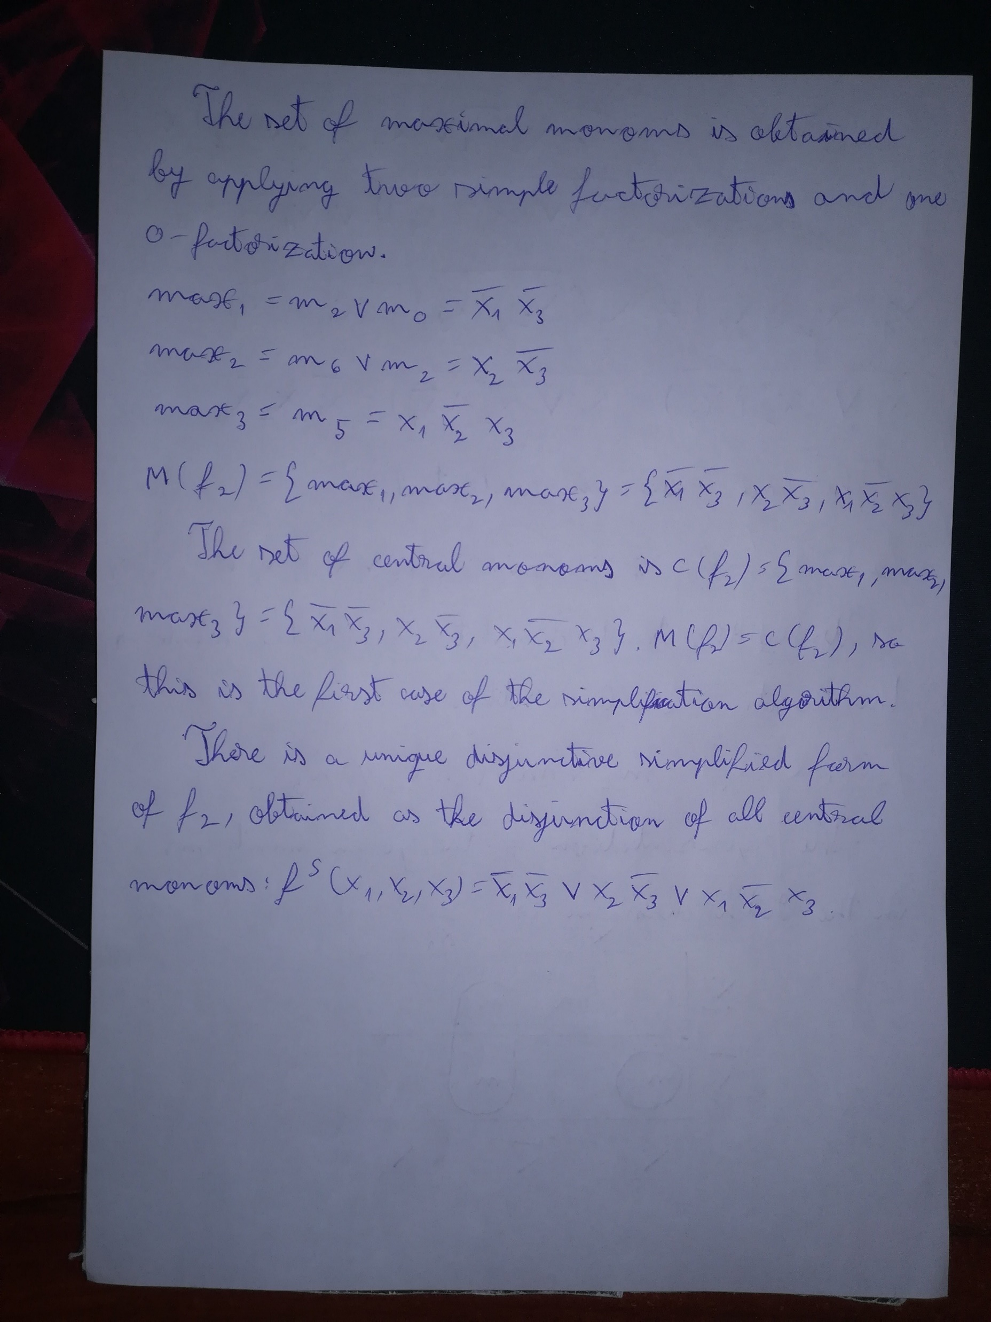

Slide 11
Conclusion

